Slide 1
An overview of thermochemical modelling of CANDU fuel and
applications to the nuclear industry
Report By: E.C. Corcoran, M.H. Kaye, M.H.A. Piro
Summary Slides by: Alex Chrystler
Notes:
This report is basically a description of the RNFTT code, and how it evolved over time. It talks about the initial development of the code and some expansions made to it, how it was validated, and use cases for current studies.

Slide 2
Overview: RNFTT
Goal: Develop a series of models for:
Thermochemistry of fuels at high temperatures
Oxidation Environment for fresh fuels
Irradiated Fuel Behavior
Chemistry of Fuel Debris in Coolant
Waste Disposal
Other Fuel Systems
CANDU Reactors
Various Amounts of Burnup/Irradiation
Horizontal Fuel Rod Geometry
Notes:
RNFTT is the RMCC (Royal Military College of Canada ) Nuclear Fuel Thermochemical Treatment

Slide 3
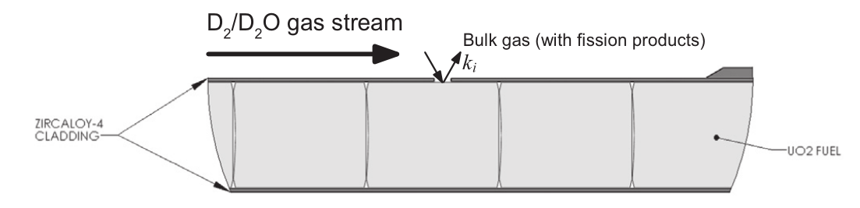
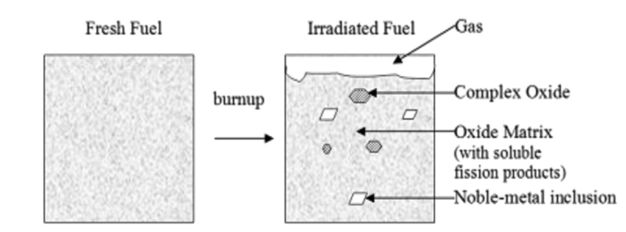
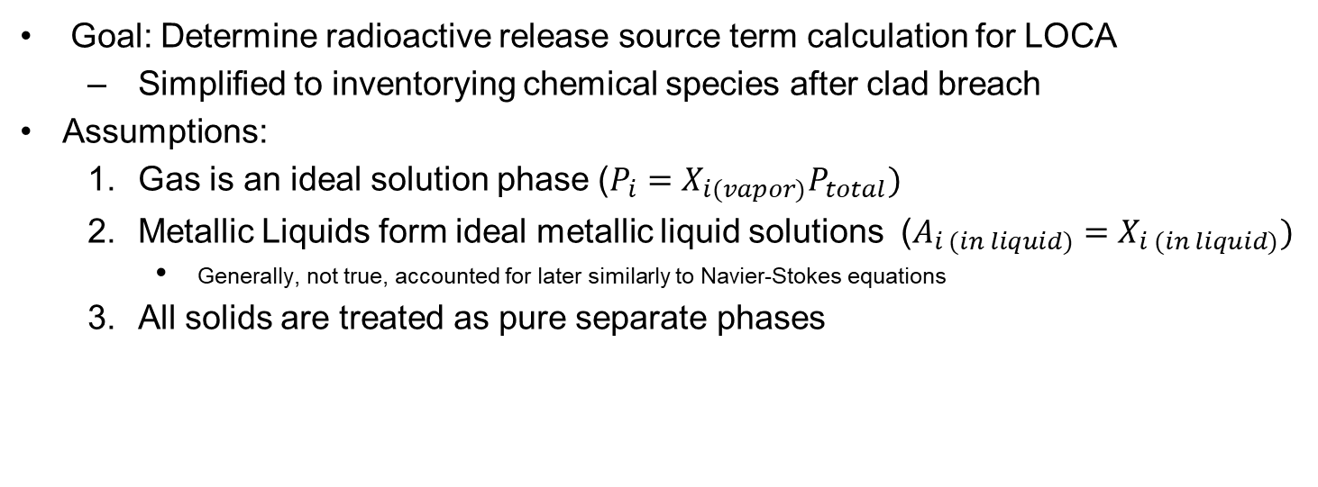
Initial Development
Goal: Determine radioactive release source term calculation for LOCA
Simplified to inventorying chemical species after clad breach
Assumptions:
Gas is an ideal solution phase ($P_{i}=X_{i(vapor)}P_{total})$
Metallic Liquids form ideal metallic liquid solutions ($A_{i (in liquid)}=X_{i (in liquid)})$
Generally, not true, accounted for later similarly to Navier-Stokes equations
All solids are treated as pure separate phases
Notes:
Overarching Goal: Be able to predict radiation transmission source as a result of a LOCA accident that causes a clad breach
Assumption 1: Partial pressures of each of the gasses in solution is equal to the pressure of the system multiplied by the mole fraction
Assumption 2: The activity of metallic liquids is equal to its mole fraction
Assumption 3: Each solid has a specific defined stoichiometry

Slide 4
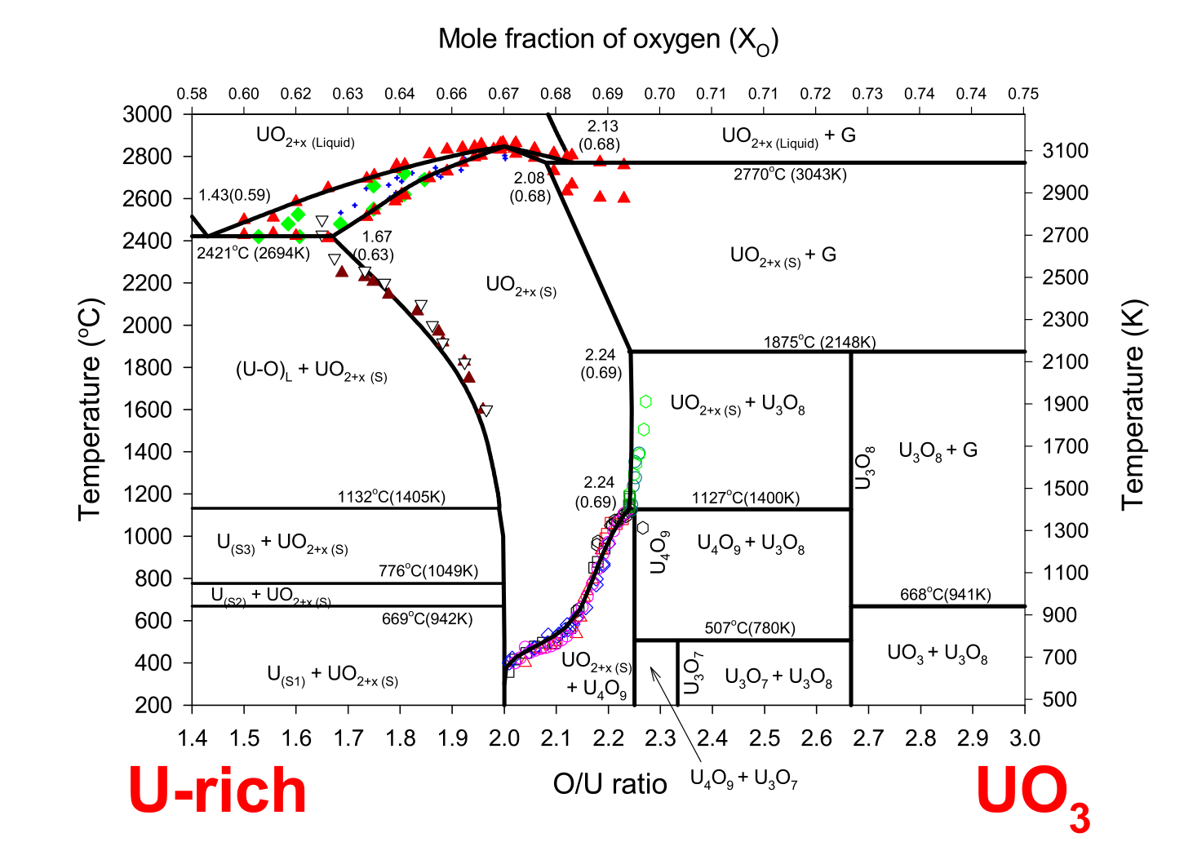
Refinements
Better handling of non-ideal noble metal alloys enhanced deficiencies in Assumption 2
Uranium-Oxygen computed phase diagram accounting for U-O system not being perfect fluorite UO₂
Incorporation of additional dissolved oxides in Uranium matrix
Modeling of additional phases in irradiated fuel
(Ba,Sr)(Fuel)O_{3/4}
(U,Pu)(Pd,Rh,Ru)₃
Notes:
First Bullet – People at the time thought that molybdenum acted as an indicator for the chemical behavior of Uranium, so they included a thermodynamic evaluation of the Noble-Metal system (Full D-orbital) (Mo, Tc, Ruthenium, Rhodium, Palladium)
Second Bullet – Hyper and Hypo stoichiometric regimes further refined the treatment. Made it easy for third bullet to happen
Third Bullet –
Fourth Bullet – “grey oxide” phase resulting from low solubility of BaO and SrO in UO₂ solid solution phase added

Slide 5
Validation
After years of development, experimental validation was necessary to determine validity and possible areas of improvement
Coulometric Titration Experiments
RNFTT shown to correctly predict Oxygen acquisition
Determined Molybdenum chemical interactions predict phase stability
Experimental Investigation of UMoO₆
RNFTT shown to predict decomposition temperature and enthalpy of formation of UMoO₆ within uncertainty range of other studies, some inconsistencies
RMCC investigating at time of writing
Notes:
CT Experiments – Ceramic tube of yttria doped with Zirconium, platinum electrodes on inside and outside walls. Exclusively O²⁻ ions able to conduct electricity. Thus, applying a known current lets you know exactly how much oxygen is added to a mixture. This was measured by the oxygen partial pressure change in a gas stream
UMoO6 – Aqueous synthesis method to produce UMoO6 examined. X-Ray Diffraction used to determine material composition, crystal structures after the fact.

Slide 6
Utilization in Thermodynamics and Multiphysics
Notes:
Nuclear Fuel Behavior codes are typically finite element or finite difference methods relying on understanding of phase equilibria, composition, oxygen chemical potential, etc. to predict fuel behavior
Multiphysics applications typically solve partial differential equations for heat and mass transport coupled with structural mechanics

Slide 7
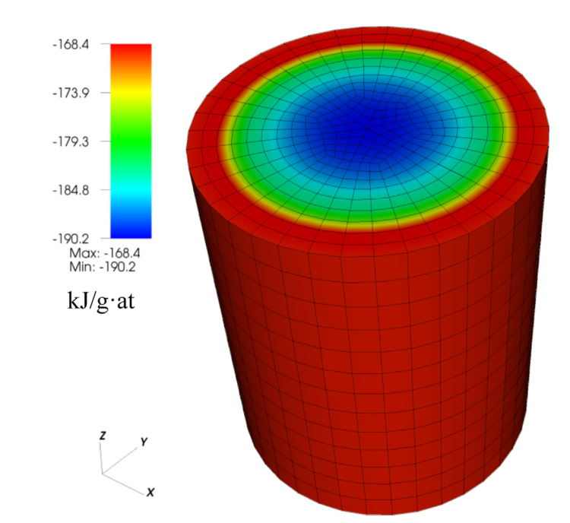
Irradiated Fuel Chemistry (Normal Conditions)
Piro et al. performed first spatiotemporal coupled thermochemical, nuclear reactions simulation of irradiated fuel
Advanced Multi-Physics (AMP) code coupled 3D heat transfer, isotropic calculations performed with Origen-S, Thermochimica
Thermochimica utilized RNFTT method to predict phase equilibria in fuel
Produced plot of Oxygen chemical potential in irradiated fuel →
Notes:
Elemental concentrations computed from nuclear physics calculations in Origen-S and temperatures computed by AMP heat transfer calculations formed inputs for Thermochimica energy minimization calculations.
Conventional approaches have gotten close to this, but those were limited to fresh fuel under a single-phase assumption and had no concept of multi-phase equilibria. This surface plot was generated for 3.5% enriched fuel and 30 GWd/t(U).
Additional benefits of this method include predicting phase formation in the fuel, and the straightforward addition of incorporating chemical effects on the Zirconium surface.
It’s also a good design space for others to produce better methods

Slide 8
Non-congruent Melting of Fuel (Severe Accident Conditions)
COSMOL multi-physics platform coupled time-dependent heat and mass transport calculations with phase model field
UO₂ fuel became hyper-stoichiometric due to fuel defect, decreasing its melt temperature & lowering thermal conductivity
Thermochemical treatment used to determine phase changes through the phase field model
Predicts local temperatures, Oxygen content, phase composition
Results compared with laser-flash melting experiments, were generally in good agreement
Notes:
Elemental concentrations computed from nuclear physics calculations in Origen-S and temperatures computed by AMP heat transfer calculations formed inputs for Thermochimica energy minimization calculations

Slide 9
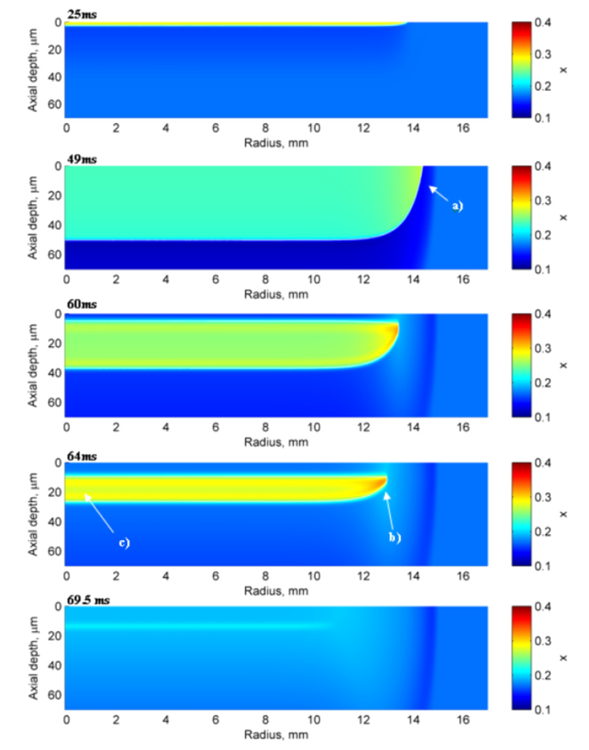
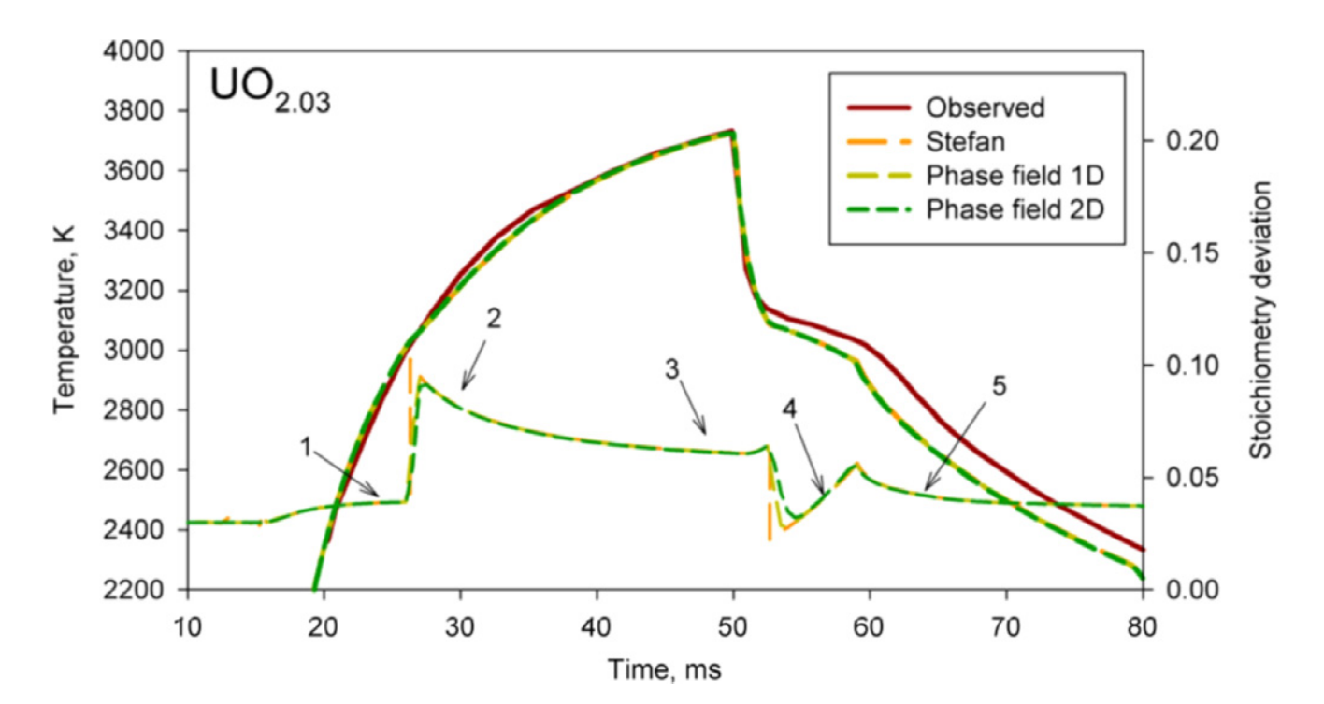
Non-congruent Melting of Fuel (Severe Accident Conditions)
Notes:
Time step 1: laser on
Time step 2: laser on
Time steps 3-5: power rapidly decreased
Point a) oxygen depletion ahead of liquid phase
Point b) local spike in oxygen concentration due to solidification
Point c) local oxygen rich regions in liquid due to axial solidification

Slide 10
Current and Future Applications
CANDU Clad Failure Prevention Methods
RMCC thermodynamic fuel treatment calculations suggest that alkali metal iodine coatings may limit gaseous iodine available to interact with Zircaloy, Oxygen produced in the reaction may repair cracks in ZrO₂ layer, negative Gibbs free energy indicates favorability
Radiation Safety
RNFTT used to investigate behavior of actinides in coolant and coolant systems. It was found that small quantities of Curium dissolve in the coolant where others are stable as solid oxides. This could lead to trapped Cm in the coolant system.

Slide 11
Summary, Analysis, Perspectives

Slide 12
Summary, Analysis
The RNFTT is a powerful system of models and a robust design space for others to implement experiments and simulations of high accuracy
Its results have been validated and verified by several experimental cases proving the accuracy of different aspects of thermochemistry, though more are being validated at time of writing
Throughout many years of development, it seems as though most of the physics involved in Nuclear Thermochemistry are at least somewhat well predicted
The uses of the RNFTT are seemingly only limited to the capabilities of the user, not the system itself. The authors claim only minor improvements are left to be made

Slide 13
Perspectives
Future applications would do well to push the limits of the capabilities of this thermochemistry framework. Finding shortcomings in our understanding of fundamental physics will lead to more potential for development, accuracy
Applications of this treatment should expand beyond the scope to allow for extension into regimes that are currently gray areas
Experimental analysis of materials at high temperatures and pressures should be performed in order to further validate and verify results from the RNFTT, as most environments don’t properly capture physics that occur at 100+ atm

